Slide 1
Basic ChIP analysis pipeline
Chen 2017.11.20

Slide 2
1. Raw data quality control
Tools: fastqc
Commands: fastqc (–o output-file) reads.fastq.gz
Key points:
1. Reads number
Indicate that if the depth is ok (20-40 million is proper)
2. Duplication level
The rate calculated by fastqc is similar to that got from samtool rmdup or picard.
3. Adapter content
Can indicate what kinds of adapters are needed to be trimmed in the next step.

Slide 3
2. Trim and filter
Tools: cutadapt or trimmomatic
Commands: cutadapt –b read1_adapter_sequence -B read2_adapter_sequence
-q 20 -O 10 --trim-n -m 30 --max-n 0.1 -o read1_trimmed.fastq.gz
-p read2_trimmed.fastq.gz Read1. fastq.gz Read2. fastq.gz
Key points:
1. Adapter sequence
According to fastqc results, we can know what adapters are needed to be trimmed.
2. cutadapt is faster and more convenient than trimmomatic.

Slide 4
3. Mapping
Tools: bowtie2 or bowtie or bwa
Commands: bowtie2 -X mm10 -1 R1_trimmed.fastq.gz -2 R2_trimmed.fastq.gz
-S mapped.sam
(About bowtie & bwa, the official websites can be refered to. )
Key points:
In bowtie2, The description as “Aligned concordantly exactly 1 time” means unique mapping;
Pay attention to mm9 or mm10;
Reference genome can be got from UCSC.

Slide 5
4. Transfer .sam to .bam
Tools: samtools view
Commands: samtools view -h –b –S mapped.sam > mapped.bam
Key points:
Remember to check the head of .sam files by “samtools view -H”.

Slide 6
5. Sort .bam files
Tools: samtools sort
Commands: samtools sort –o mapped_sorted.bam mapped.bam
Key points:
Remember to check the head of .bam files.

Slide 7
6. Get unique mapped .bam files
Tools: samtools view
Commands: samtools view –h –bq 30 file.bam > sorted_file.bam
Key points:
MAPQ >= 30
Also can be filtered with tags.

Slide 8
7. Remove duplicates
Tools: samtools rmdup
Commands: samtools rmdup sorted.bam deduplicated.bam
Key points:
The rates in the end of the output on the screen is the duplication rates;
It is default that 1 read of duplication will be kept. (the same as Picard)

Slide 9
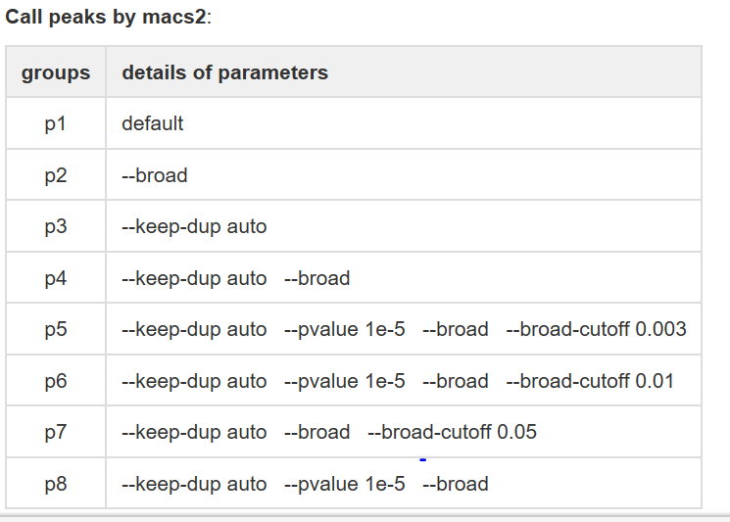
8. Call peaks
Tools: macs2
Commands: 8 sets of parameters (According to what you need.)

Slide 10
9. Normalization and IGV visualization
Tools: deeptools: bamCompare or bamCoverage ----- to get bigwig files (Normalize to 1M or 10M)
Commands: bamCoverage --scaleFactor 1,000,000/reads -b deduplicated.bam -o file.bw
Key points:
1M or 10M, it depends on the number of reads left;
We often use bamCoverage but not bamCompare.

